Slide 1
Effective Knowledge Distillation for Semantic Segmentation
EE5001
Yao Yuan, A0232893X, e0724692@u.nus.edu

Slide 2
Content
Introduction
Approach
Basic network structure
Knowledge distillation strategy
Online hard example mining
Results
Dataset: Cityscape, Nyudv2
Experiment results
Conclusion

Slide 3
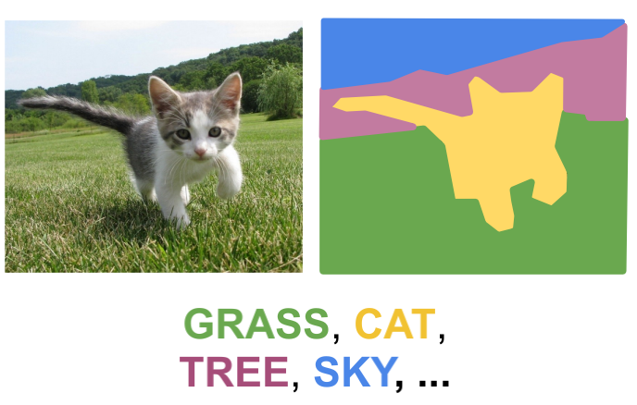
Introduction
1
Semantic Segmentation is to classify each pixel with a label. Deep neural networks have been the dominant solutions for semantic segmentation since the invention of fully convolutional network (FCN).
Long, Shelhamer, and Darrell, “Fully Convolutional Networks for Semantic Segmentation”, CVPR 2015

Slide 4
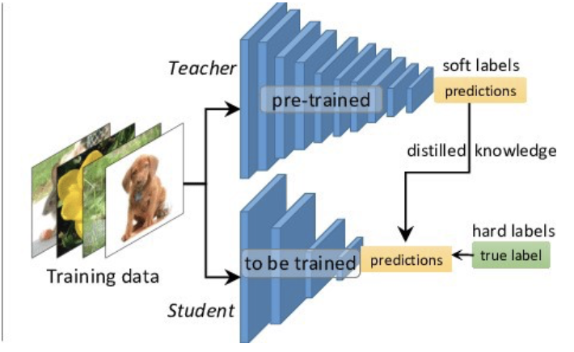
Introduction
1
Problem：The structure of network is more and more complex….
Knowledge distillation
Transfer the knowledge from complex model to compact model
Improve the performance of compact model
Hinton et al., “Distilling the Knowledge in a Neural Network”, 2015
Prakhar Ganesh. "Knowledge Distillation : Simplified". , 2019.

Slide 5
Approach
2

Slide 6
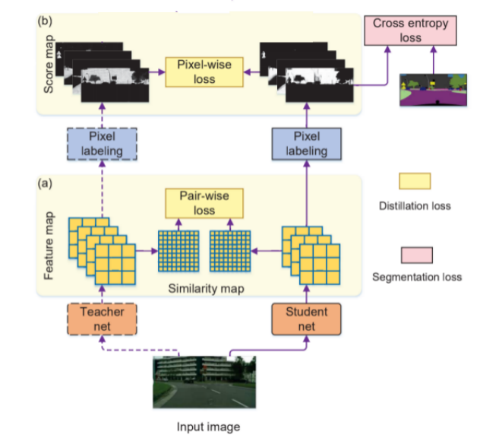
Basic network structure
2.1
Teacher net help to improve the generalization ability of Student net
Two knowledge distillation strategies: Pixel-wise and Pair-wise

Slide 7
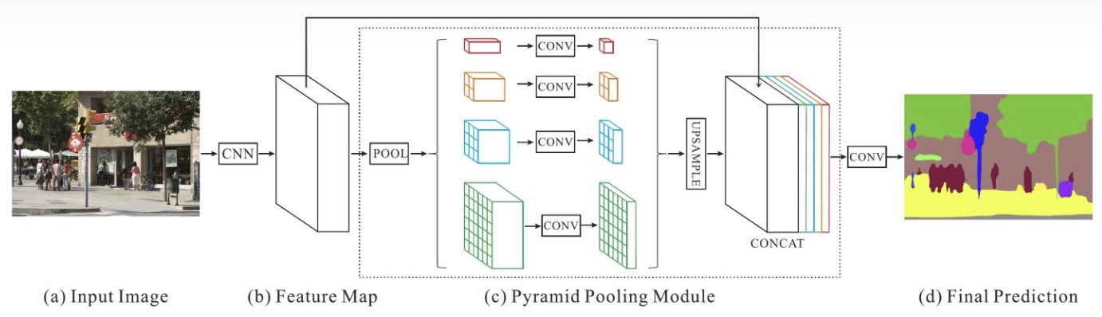
PSPNet
2.1
PSPNet: Add PPM(Pyramid Pooling Module). Using different size of kernels to pooling the feature map X from encoder, upsample the feature map back to same size of X, then combine the feature map together. PPM can improve the receptive field of deep layer of network.
Hengshuang Zhao et al., “Pyramid scene parsing network.”, IEEE 2017

Slide 8
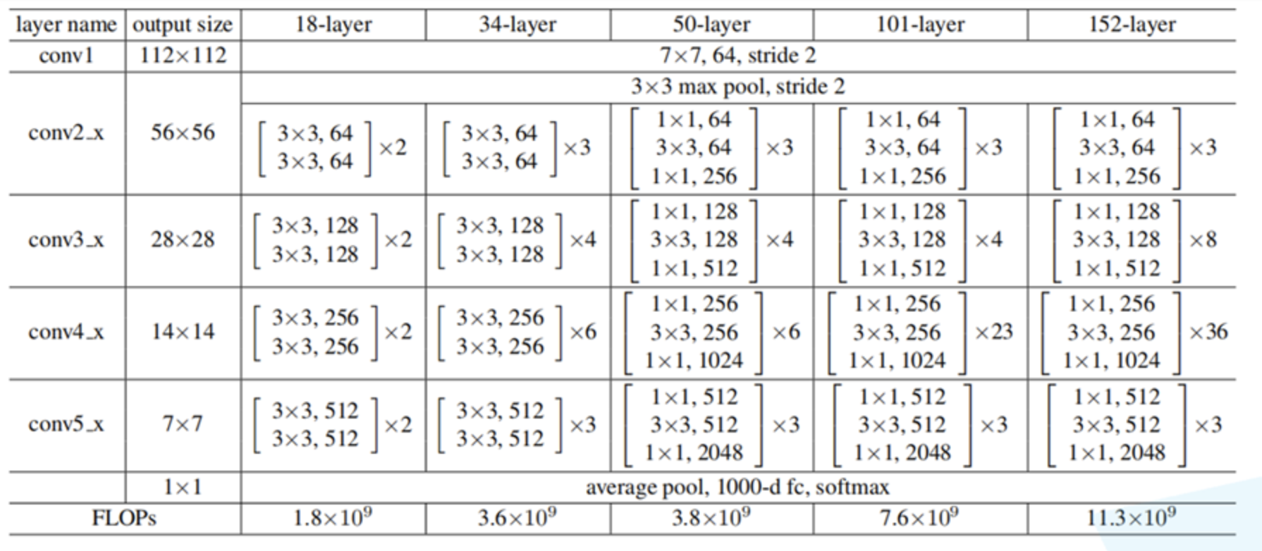
ResNet
2.1
ResNet: Using residual block to build deep network.
Teacher net: Resnet101
Student net: Resnet18
Kaiming He et al., “Deep Residual Learning for Image Recognition.”, CVPR, 2016

Slide 9
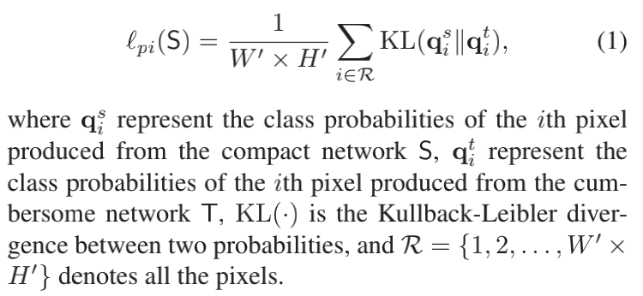
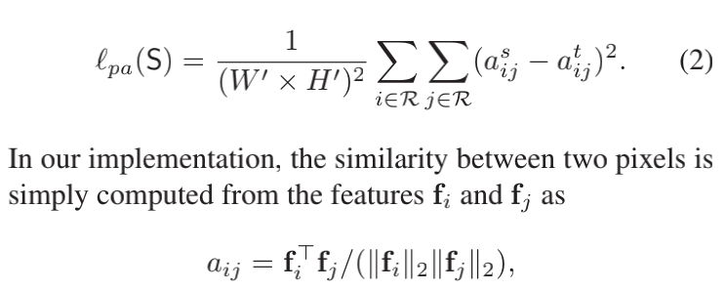
Knowledge distillation strategy
2.2
1.Pixel-wise distillation(PI)
Use the predict softmax value of Teacher net as the soft target.
2.Pair-wise distillation(PA)
Use spatial continuity(Markov random field) of Teacher net to train the spatial continuity of Student net.
Liu Y , Chen K , Liu C , et al. “Structured Knowledge Distillation for Semantic Segmentation”. CVPR, 2019.

Slide 10
Online hard example mining
2.3
Basic idea of OHEM: Try to only use the pixels with large loss to update the weight
In each step do the forward to compute loss for every pixel
Select of hard pixels(big loss)
Do backward for the hard pixels, compute the gradient and update the weights.
Two main parameters: threshold and min kept pixels.
Threshold: When the softmax value of predicted probability in ground true label of a pixel is less than the threshold, the pixel will be kept in the backward phase.
Min kept pixels is the minimum kept pixels in every step.
In the experiments, the threshold always 0.7 and min kept pixels equal 100000.
Shrivastava A, Gupta A, Girshick R. “Training Region-based Object Detectors with Online Hard Example Mining[J]”. IEEE , 2016

Slide 11
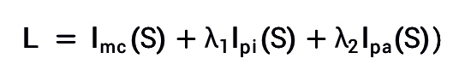
Loss function
2.3
The whole loss function consists of three parts:
Multi-class cross entropy between ground truth pixel label and student net predict pixel label.
Pixel-wise loss (PI)
Pair-wise loss (PA)
The OHEM is used in part1.
Notes:
Where is set to be 1 or 10 in the experiments, and is set to be 1.

Slide 12
Results
3

Slide 13
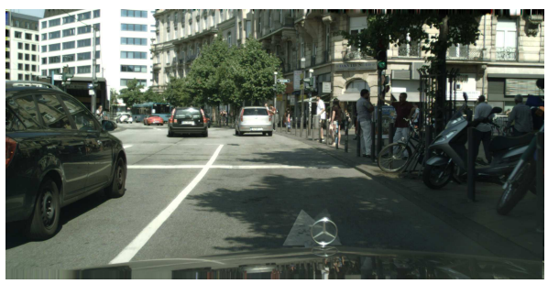
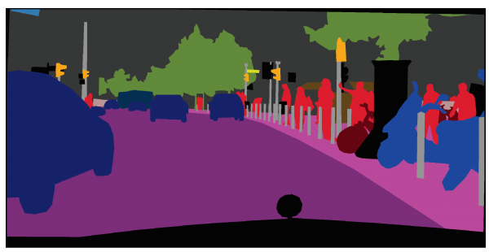
Datasets
3.1
Cityscapes
Collected for semantic urban scene understanding. It contains 5,000 high quality pixel-level finely annotated images which are divided into 2, 975/ 500/ 1, 525 images for training, validation and testing. Also has 2,0000 coarsely images which is not used in my experiments. The finely annotated dataset in our experiments has 19 different categories which is transformed from original 30 categories.

Slide 14
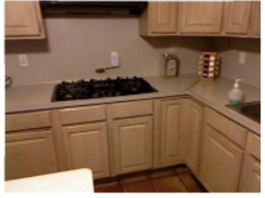
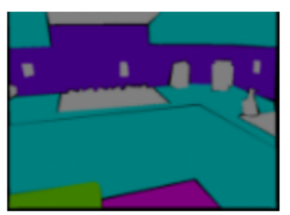
Datasets
3.1
Nyudv2
Video sequences of various indoor scenes recorded by RGB and Depth camera of Microsoft Kinect. It contains 1449 RGB images, including 795 training images and 654 test images. The original dataset contained 40 categories of pixel level classes, and I use the transformed 14 categories version for this project.

Slide 15
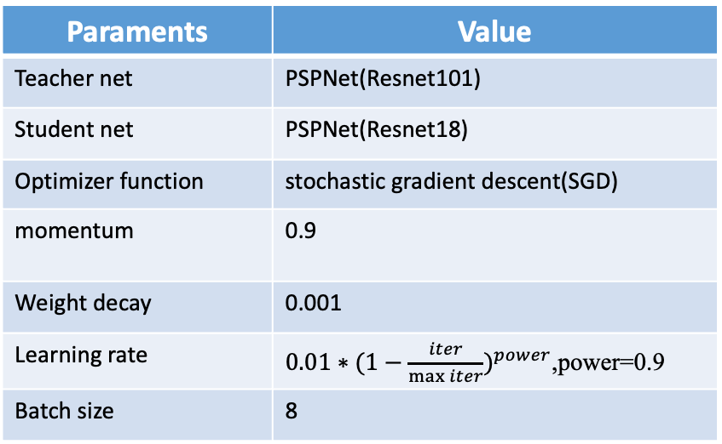
Experiments
3.2
Paraments | Value
Teacher net | PSPNet(Resnet101)
Student net | PSPNet(Resnet18)
Optimizer function | stochastic gradient descent(SGD)
momentum | 0.9
Weight decay | 0.001
Learning rate | $0.01∗{(1−\frac{iter}{\max{iter}})}^{power}$,power=0.9
Batch size | 8
Data augment:
Random scaling
Random rotating
Add Gaussian blur
Random Flipping
Notes:
the “poly” learning rate policy

Slide 16
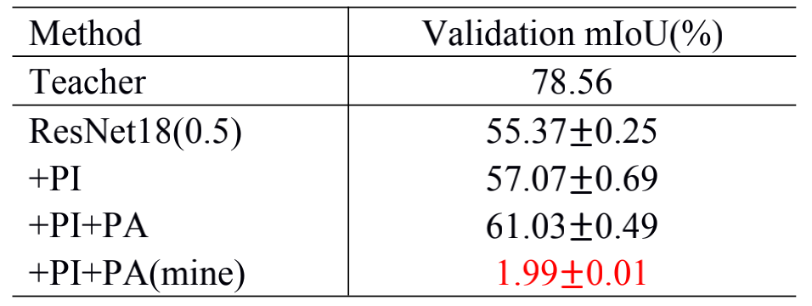
Experiments
3.2
Stage 1. Reproduce the result of paper[1]
Result: Failed
Because the parameters used in knowledge distillation is not suitable.
[1]Liu Y , Chen K , Liu C , et al. Structured Knowledge Distillation for Semantic Segmentation. In CVPR, 2019.
Notes:
the “poly” learning rate policy

Slide 17
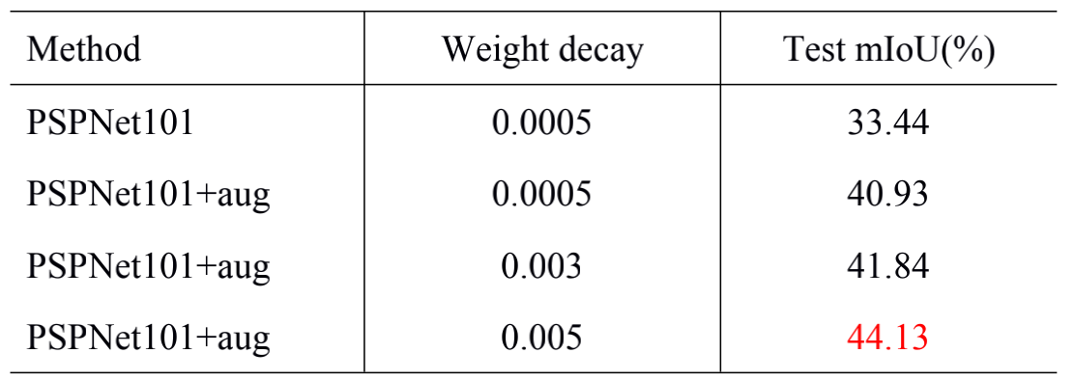
Experiments
3.2
Stage 2. Test in Dyudv2
Severe overfitting
1.Try to use multiple methods of data augment
2.Increase the weight decay in the optimization function
Notes:
Train teacher network first

Slide 18
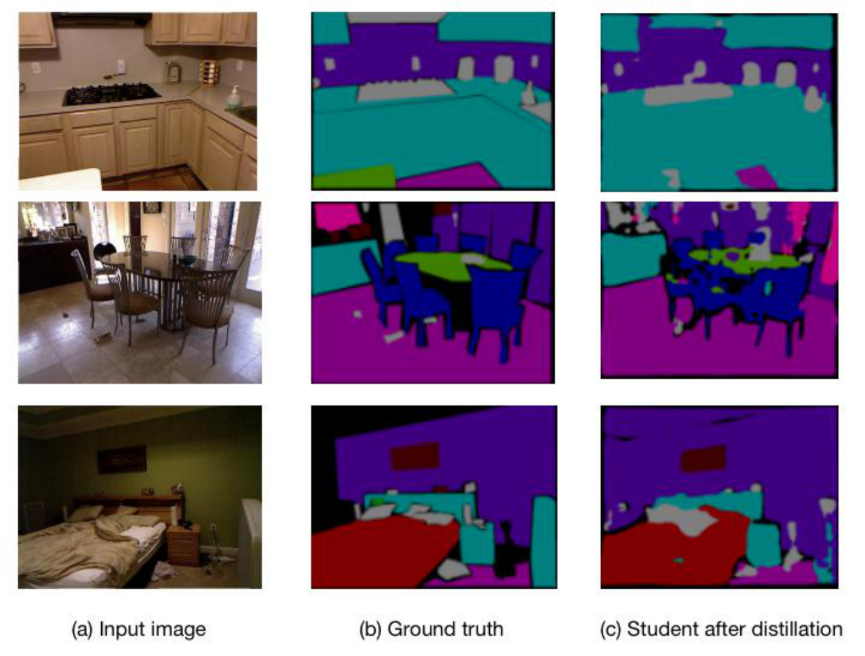
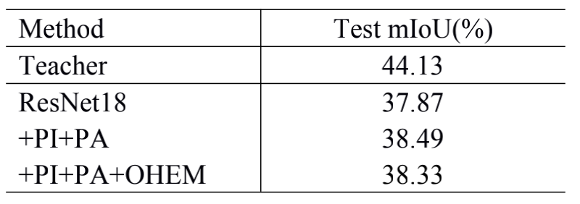
Experiments
3.2
Stage 2. Test in Dyudv2
Effectiveness of knowledge distillation and OHEM
1.Performance is improved 0.62% after knowledge distillation
2.OHEM strategy need more experiments to test(Different threshold and min-kept number)
Notes:
the “poly” learning rate policy

Slide 19
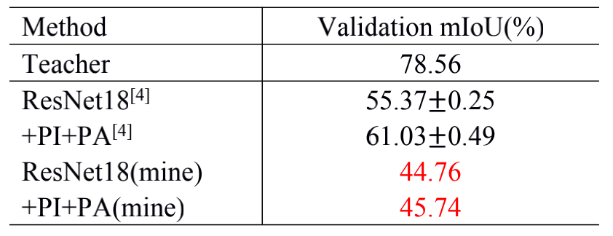
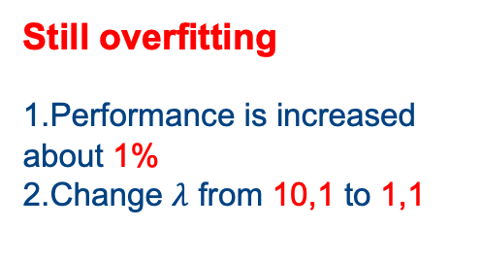
Experiments
3.2
Stage 3. Test in Cityscapes
Still overfitting
1.Performance is increased about 1%
2.Change $λ$ from 10,1 to 1,1
Notes:
Train teacher network first

Slide 20
Conclusion
4
Stage 2
Knowledge distillation strategy PI and PA can effectively improve results of student net.
Stage1 and 3
Parameters in Knowledge distillation are very sensitive
To be solved
Effectiveness of OHEM strategy need more test.
Overfitting is important problem in knowledge distillation

Slide 21
THANK YOU

